Slide 1
SHWN_ULUC (UNIVERSAL LOGISTICS USA INC)
Always key the following, visible in the invoice separator sheet:
Batch ID (68) BAT ID (69) Value/No
Client Code (68) CL CODE (69) SHWN
Scac Code (68) SCAC CODE (69) ULUC

Slide 2
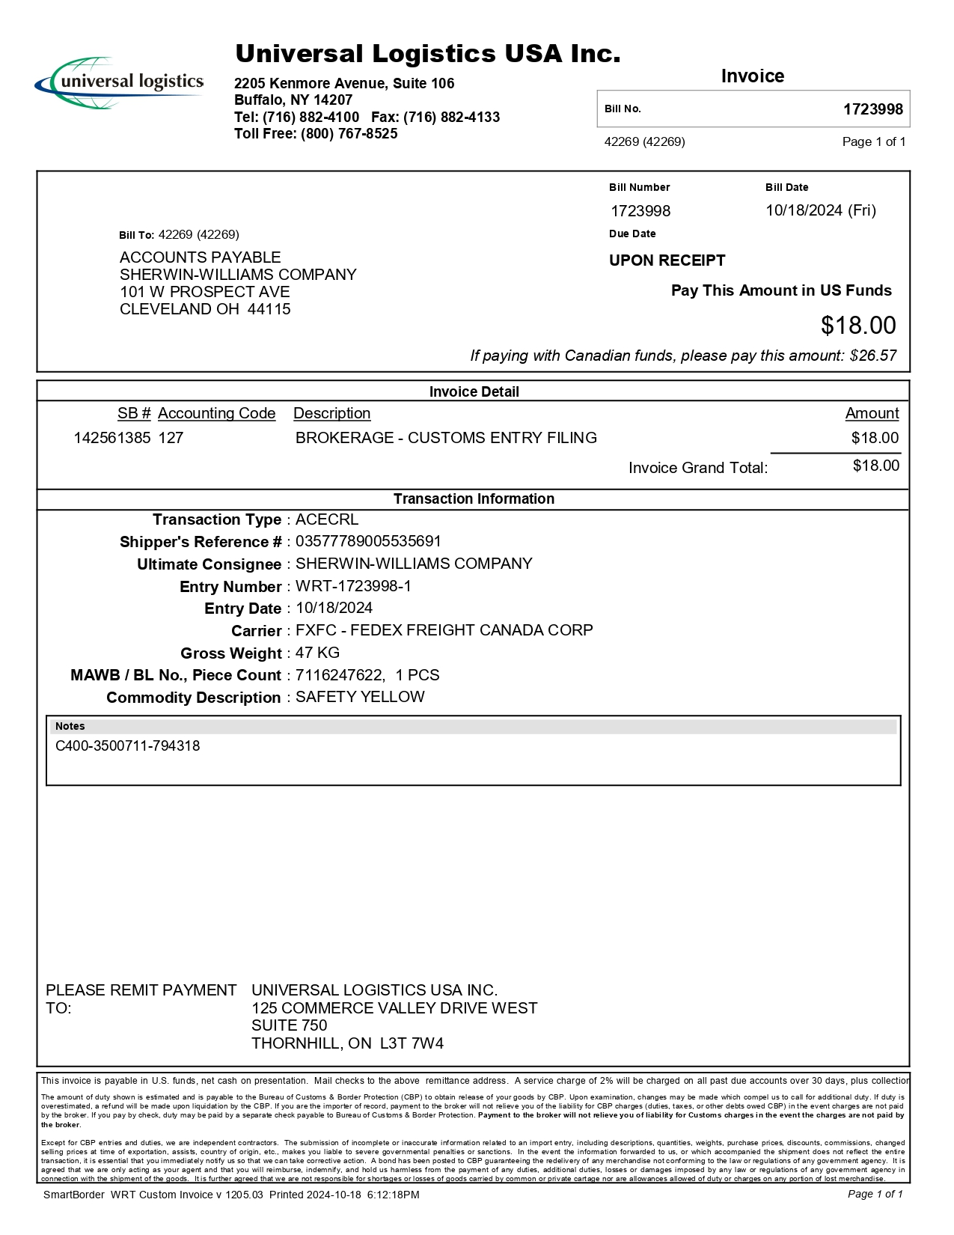
03
FORMAT A - 1/3
05
10
02
09
08/14
01 REMIT TO
02 BILL TO
03 INV KEY 05 ACCT 10 DATE 30 CONSIGNEE INV
42/43 ACTUAL WT/ FNCL WT
44/45 WT UOM
46 PIECES
47 PIECES TYPE 61 PICK UP
68a REF
68b MAWB
72 LINE ITEM DESC
85 LINE ITEM AMT
90 PROD DESC 08/14 INV AMT/FB AMT
09 CURR
72
85
68a
30
42/43
61
44/45
68b
90
46
47
01

Slide 3
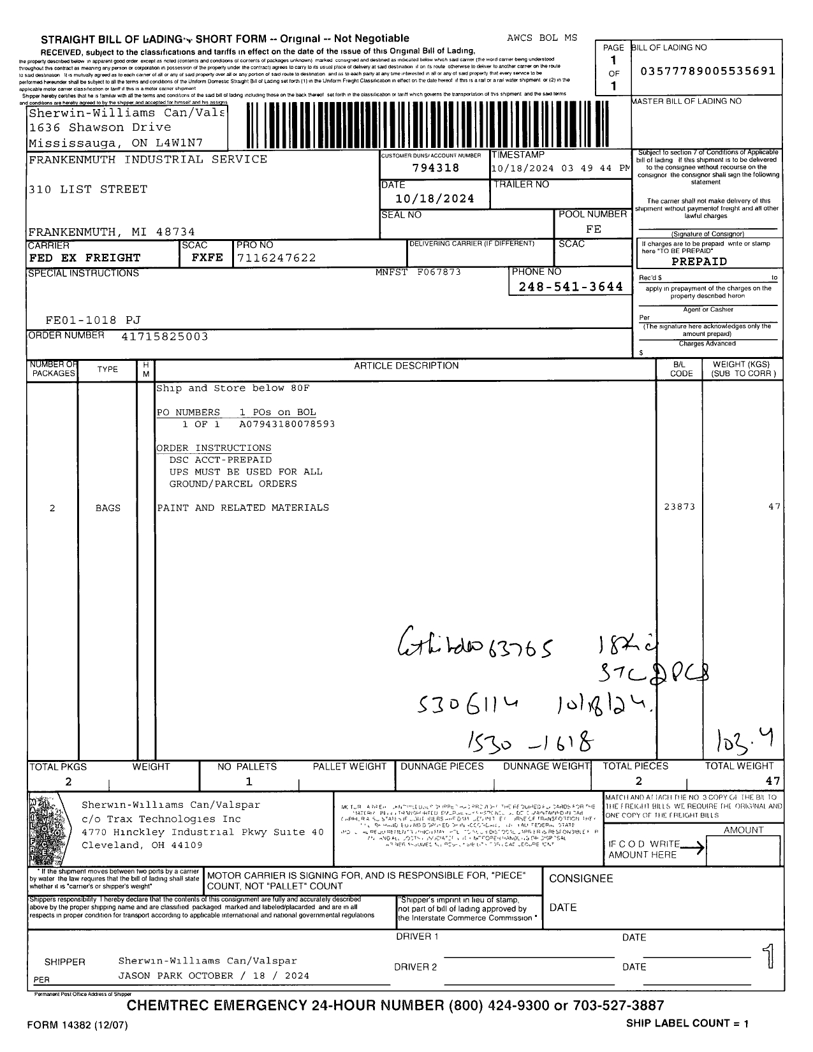
68a
FORMAT A - 2/3
27
30
61
36
27 SHIPPER BOL
30 CONSIGNEE BOL
36 FREIGHT TERM
61 PICK UP
68a BOL
68b ORD
68c PO
90 PROD DESC
95 PCS CNT
96/97 GROSS WT/NET WT
98 WT UOM
68b
98
68c
90
95
96/97

Slide 4
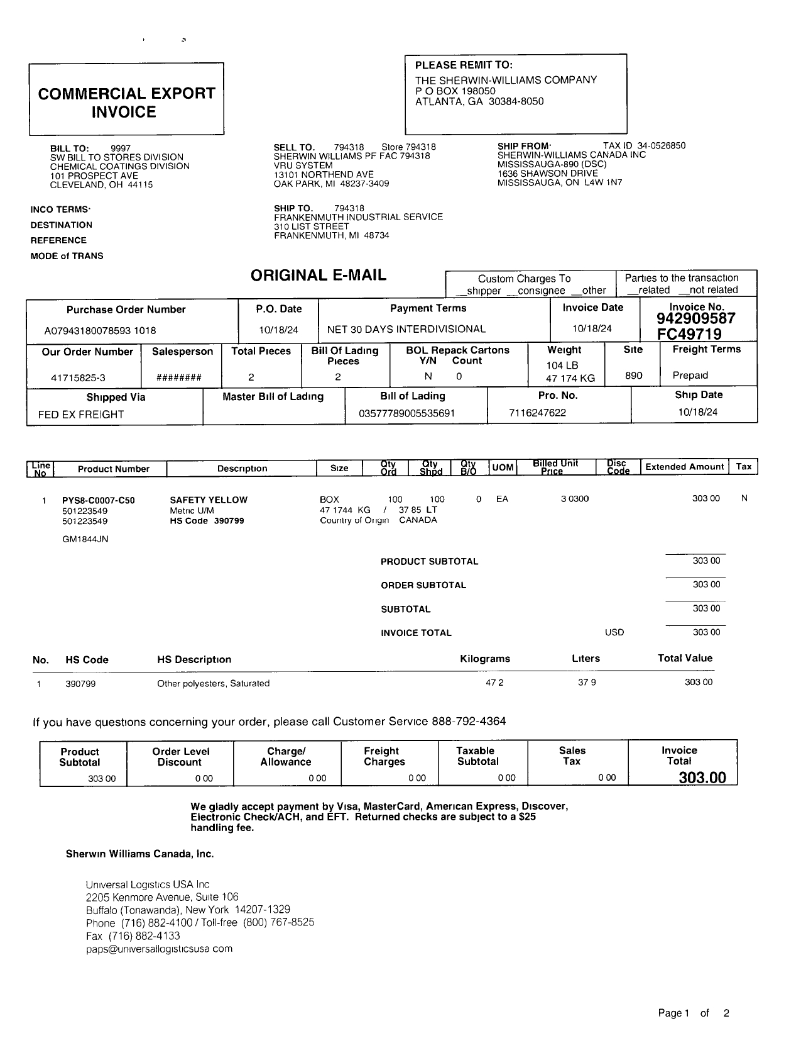
FORMAT A – 3/3
29
32
29 SHIPPER COM
32 CONSIGNEE COM

Slide 5
6
For Verification Table
 | NAME | DATE
DI-65225 | KHEILA MARY INOC | 10/23/2024
DI-67298 – updated as per instruction (slide 2) | PHILLIP L. RAMISCAL | 1/20/2025
DI-75451 – Added new invoice format (slide 5, 6 and 7) QA-Marivic | BABY G. VILLACARLOS | 10/31/2025
DI-75681 – Removed Format B, slide 5-7 , UNIVERSAL LOGISTICS REMIT TO USA = ULUC | Marivic Ebo | 11/10/2025

